Slide 1


MICROMOUSE 2024
Applied Mechatronics Lab
07/08/2024

Slide 2
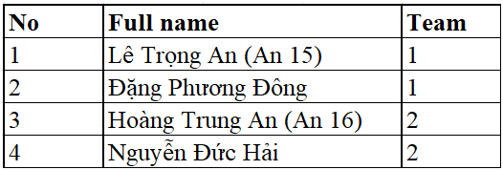


Schedule
Notes:
Therefore, my presentation includes 6 sections, followed by my research workflow. In Section 1, I present the background, challenges and objectives of my research. Section 2 is for my invented technique which mainly used. Section 3,4, and 5 provides more detail of the properties of three prototypes I have made. And Section 6 is the Conclusion and future work.

Slide 3
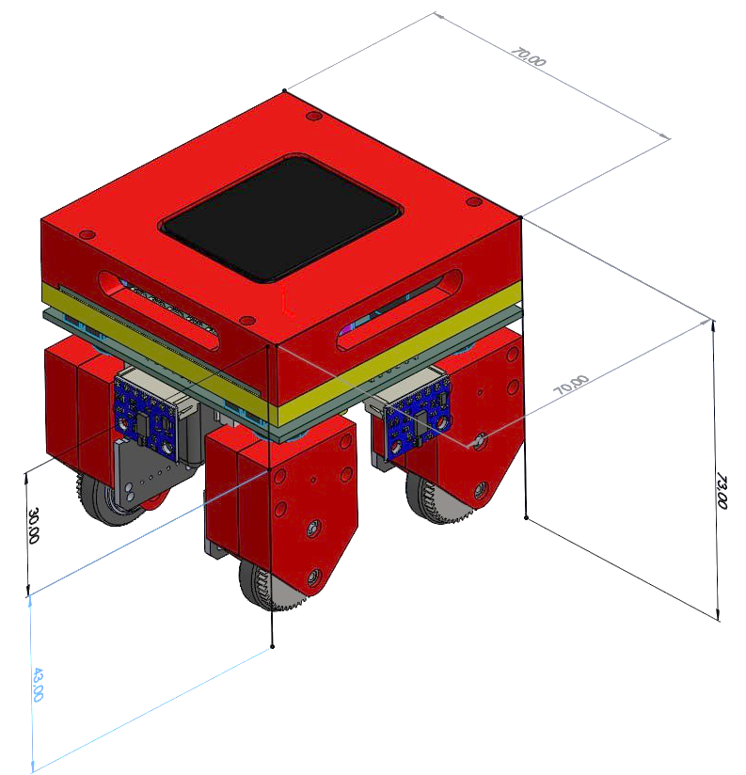
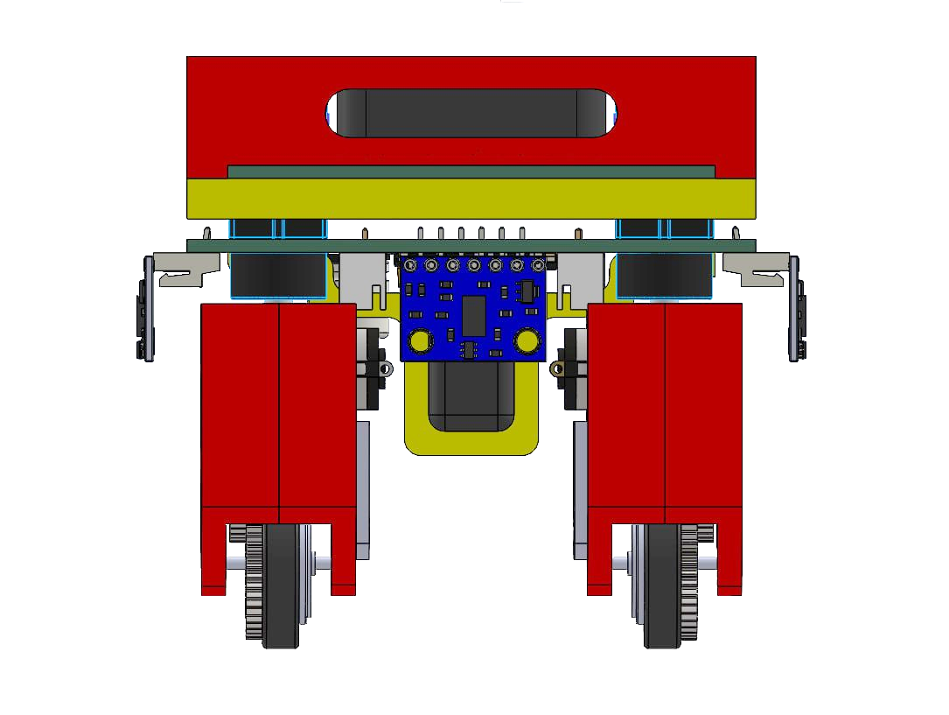
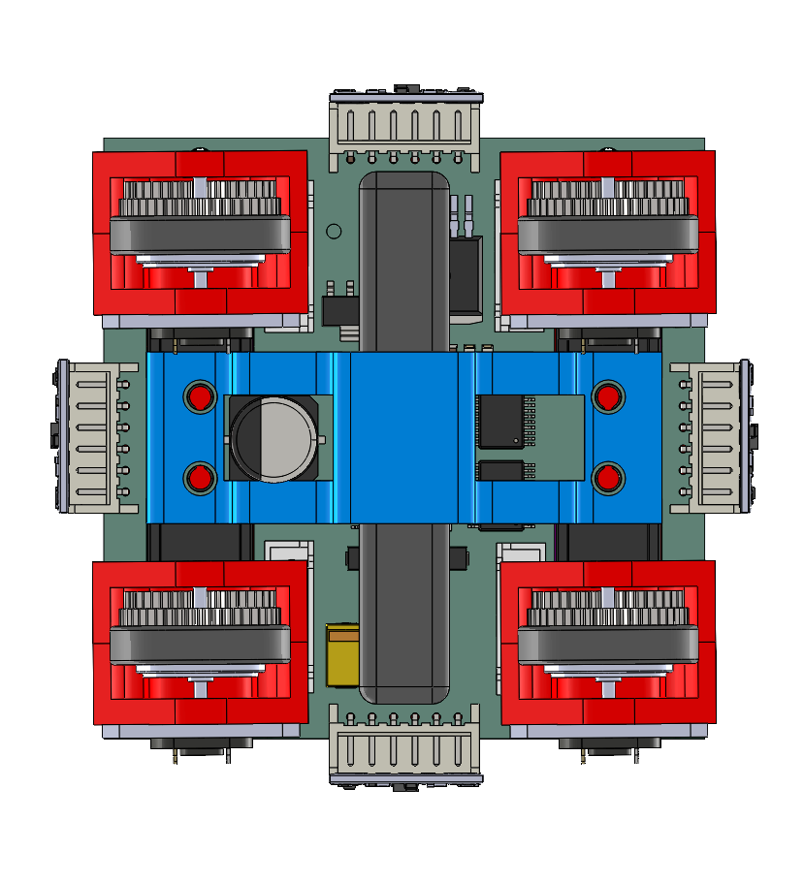
TEAM 1
Notes:
Therefore, my presentation includes 6 sections, followed by my research workflow. In Section 1, I present the background, challenges and objectives of my research. Section 2 is for my invented technique which mainly used. Section 3,4, and 5 provides more detail of the properties of three prototypes I have made. And Section 6 is the Conclusion and future work.

Slide 4
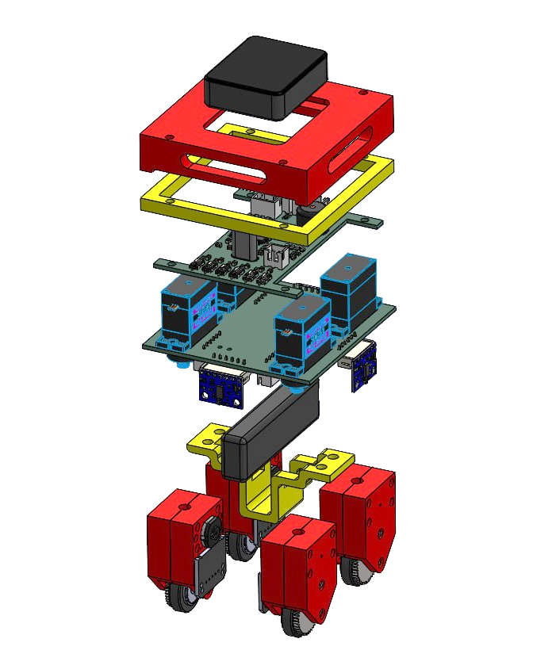
TEAM 1
Màn hình ESP32
Case bảo vệ trên
Gá 2 mạch
PCB tầng trên
Servo quay cụm bánh (SG90S) x4
PCB tầng dưới
Cảm biến laser
VL6180X x4
Gá pin
Pin Lipo 2S
Cụm bánh x4
Notes:
Therefore, my presentation includes 6 sections, followed by my research workflow. In Section 1, I present the background, challenges and objectives of my research. Section 2 is for my invented technique which mainly used. Section 3,4, and 5 provides more detail of the properties of three prototypes I have made. And Section 6 is the Conclusion and future work.

Slide 5
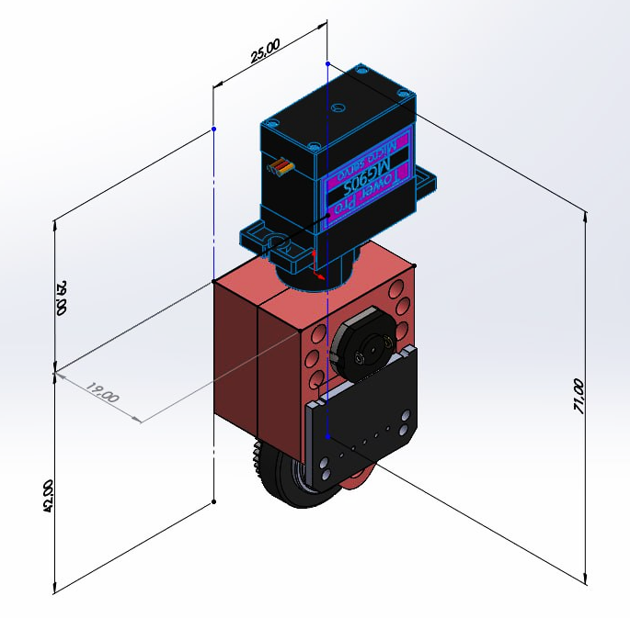
TEAM 1
Notes:
Therefore, my presentation includes 6 sections, followed by my research workflow. In Section 1, I present the background, challenges and objectives of my research. Section 2 is for my invented technique which mainly used. Section 3,4, and 5 provides more detail of the properties of three prototypes I have made. And Section 6 is the Conclusion and future work.

Slide 6
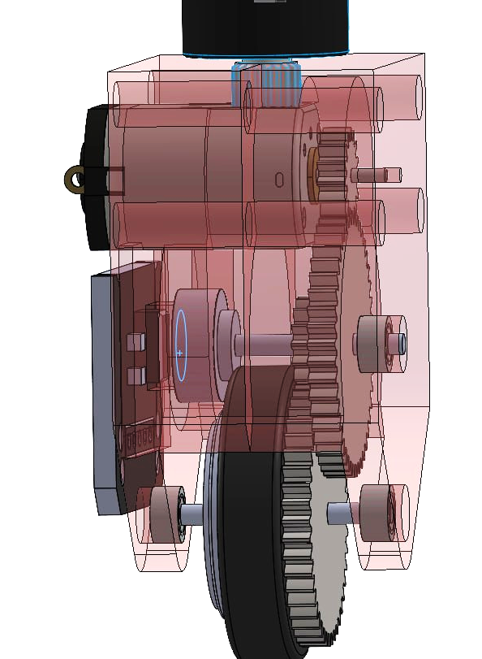
TEAM 1
*CỤM BÁNH SỬ DỤNG BÁNH RĂNG 0.4M
Bánh răng z1 = 15
Động cơ N20
10x8x15 (mm)
Trục 1mm dài 5mm
Bánh răng z2 = 45
Encoder từ MT6701
Bánh răng z2’ = 15
Nam châm cho encoder từ
Bánh răng z3 = 45
Tỉ số truyền: 1:9
Vòng bi 1.5x4x2 (mm) x3
Notes:
Therefore, my presentation includes 6 sections, followed by my research workflow. In Section 1, I present the background, challenges and objectives of my research. Section 2 is for my invented technique which mainly used. Section 3,4, and 5 provides more detail of the properties of three prototypes I have made. And Section 6 is the Conclusion and future work.

Slide 7
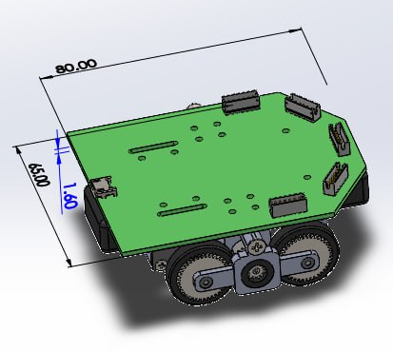
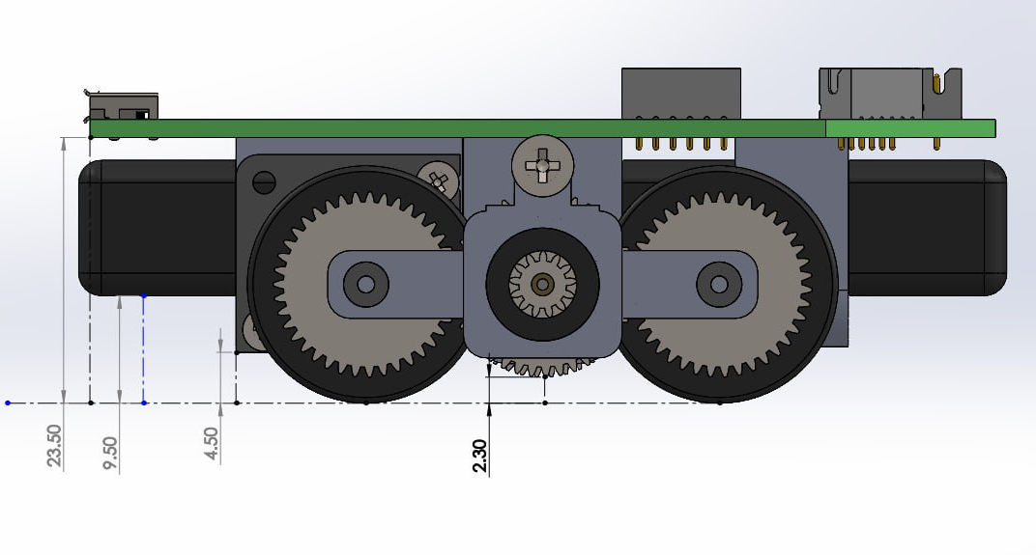
TEAM 2
Notes:
Therefore, my presentation includes 6 sections, followed by my research workflow. In Section 1, I present the background, challenges and objectives of my research. Section 2 is for my invented technique which mainly used. Section 3,4, and 5 provides more detail of the properties of three prototypes I have made. And Section 6 is the Conclusion and future work.

Slide 8
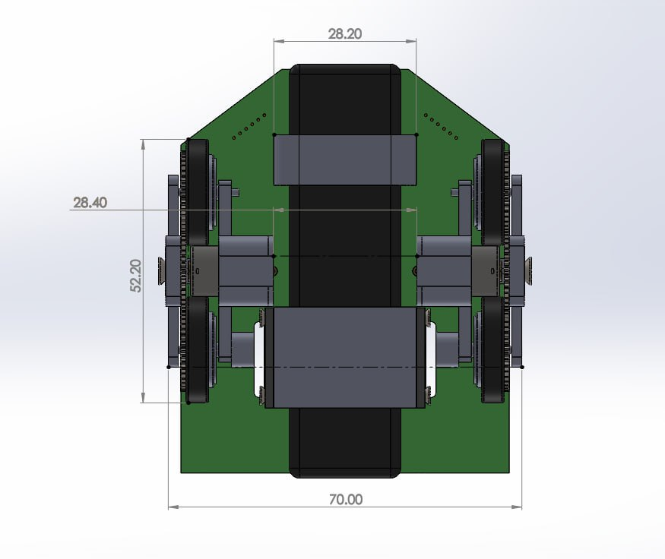
TEAM 2
Notes:
Therefore, my presentation includes 6 sections, followed by my research workflow. In Section 1, I present the background, challenges and objectives of my research. Section 2 is for my invented technique which mainly used. Section 3,4, and 5 provides more detail of the properties of three prototypes I have made. And Section 6 is the Conclusion and future work.

Slide 9
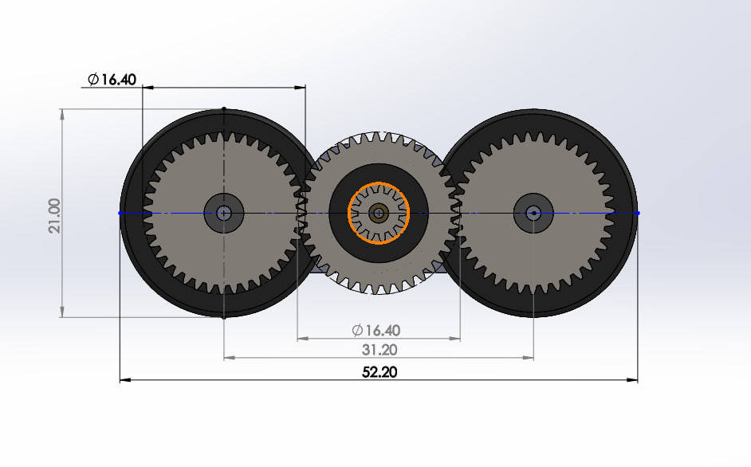
TEAM 2
Notes:
Therefore, my presentation includes 6 sections, followed by my research workflow. In Section 1, I present the background, challenges and objectives of my research. Section 2 is for my invented technique which mainly used. Section 3,4, and 5 provides more detail of the properties of three prototypes I have made. And Section 6 is the Conclusion and future work.

Slide 10
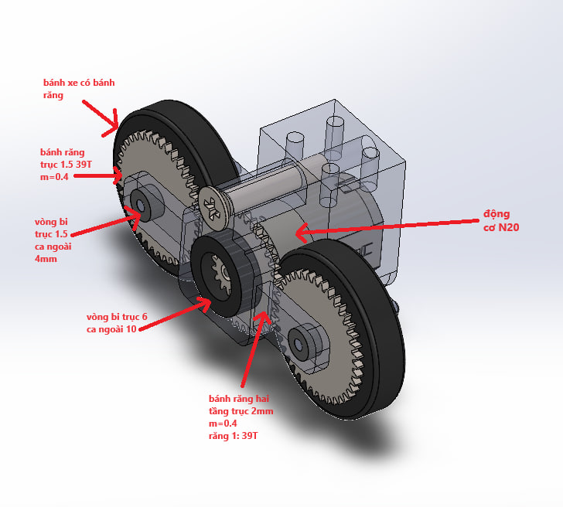
TEAM 2
Notes:
Therefore, my presentation includes 6 sections, followed by my research workflow. In Section 1, I present the background, challenges and objectives of my research. Section 2 is for my invented technique which mainly used. Section 3,4, and 5 provides more detail of the properties of three prototypes I have made. And Section 6 is the Conclusion and future work.

Slide 11

THANK YOU

